Slide 1
Live Subtitles Using Augmented Reality
FYP Mid-year Evaluation
Group Member | CGPA | Roll Number
Ifrah Ishtiaq | 3.772 | (CS-132)
Ameema Arif | 3.667 | (CS-122)
Mahrukh Khan | 3.666 | (CS-003)
Syeda Sara Akif | 3.500 | (CS-002)

Slide 2
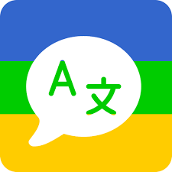
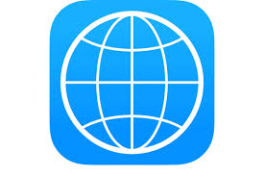

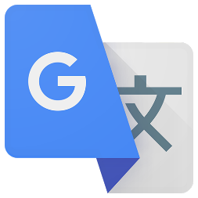
PROJECT BACKGROUND
There are many online and offline translating softwares but too frustrating as they require the user to shift focus from text to the people talking.
Also, in many applications, the function of turning on/off i.e translating again and again could get very tedious.
translatez
itranslate
Snaptrans
Googletranslate

Slide 3
PROJECT INTRODUCTION
What is our project about?
Who will it help?
Are there any similar products available commercially?
If YES, how is our project different?

Slide 4
PROJECT INTRODUCTION
What is our project about?
Live Subtitles is an Android Application which provides:
Real-time speech to text conversion allowing the users to view and read the speaker’s speech in live conversations.
Designed as an Android App to ease users in their daily lives.
Implemented using AR to allow the text to be overlaid on screen of the user’s mobile.
Allowing User to view the Subtitles in either English or Urdu as per their desire.

Slide 5
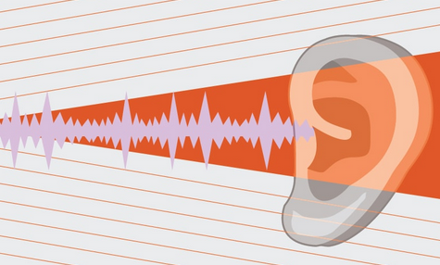
Who will it help?
1.
People with Hearing Disabilities:
According to WHO, over 5% of every country's population suffers from some sort of hearing impairment which means that currently there are approximately 10 million citizens in Pakistan and 466 million people all around the globe who are hearing impaired. Moreover, It is estimated that by 2050, one in every ten people will have a disabling hearing loss.
There is a great need for a medium that will help include such huge amount of people.

Slide 6
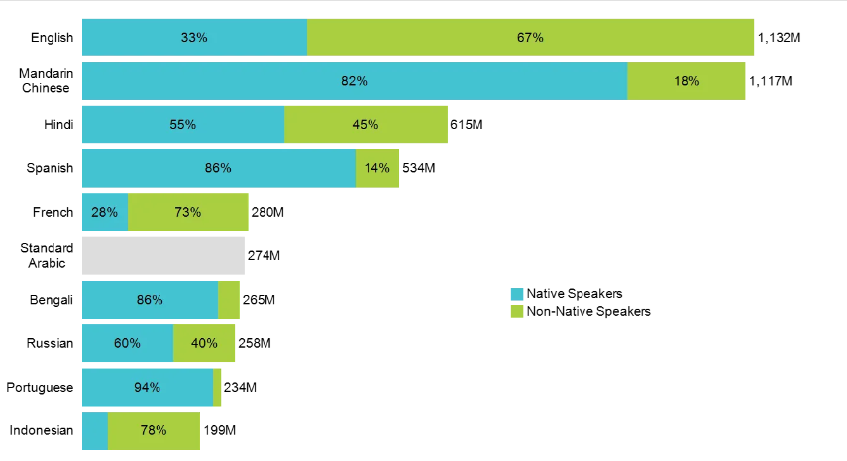
Who will it help?
2.
People with different languages:
Great content transcends language boundaries but only if it’s translated.
People from all over the world understand different languages and even locally, different people are comfortable with different languages.
According to a survey, about 90% of organizations struggle with language barriers in their day-to-day work.
Our application is aimed at removing this linguistic barrier.

Slide 7
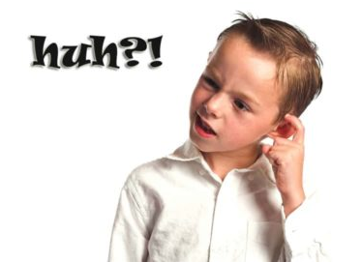

How does it help?
3.
Improved Comprehension
Using subtitles alongside listening, lip reading could help ease concentration fatigue for listeners and help with missed out information. Given that some people learn through watching and reading, visuals like subtitles in real world could improve learning by up to 400 percent by affecting users on a cognitive level and allowing them to have better understanding.
Therefore, Our app will enable users to process the information faster and better.

Slide 8
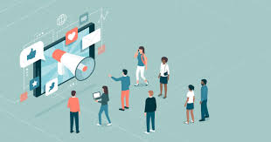
How does it help?
4.
Increased Engagement
Statistics show that subtitles are inherently more captivating.
According to a recent study, captioned videos had a 40% increase in views and were 80% more likely to be seen till end. Hence, a conversation stands a much better chance at having an impact if it is conveyed with captions.

Slide 9
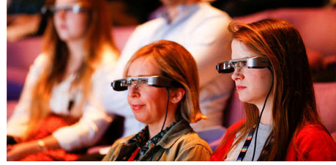
Are there any similar products available commercially?
London’s Royal National Theatre offers “Smart Glasses”
If YES, how is our project different?
Smart Glasses display already defined subtitles making them limited to the theatres.
These glasses cost roughly $1,050 per pair making them very expensive and unaffordable to most people.
Smart Glasses could also be very uncomfortable to wear, specially for longer times.

Slide 10
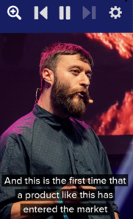
Are there any similar products available commercially?
2. Shravan Apps by Oswald Labs offer “Live Subtitles” android application.
If YES, how is our project different?
Live Subtitles is an Indian product yet to hit market. The date for release is not announced.

Slide 11
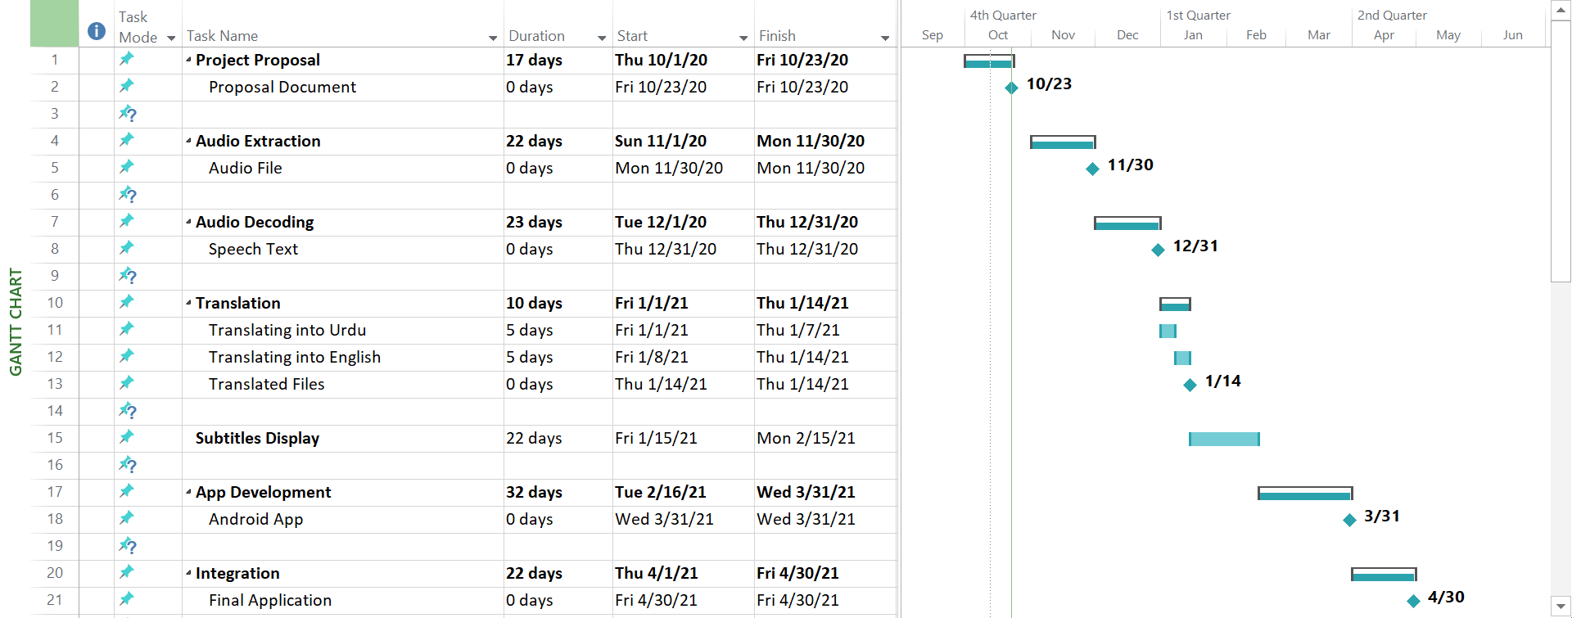
Gantt CHART

Slide 12
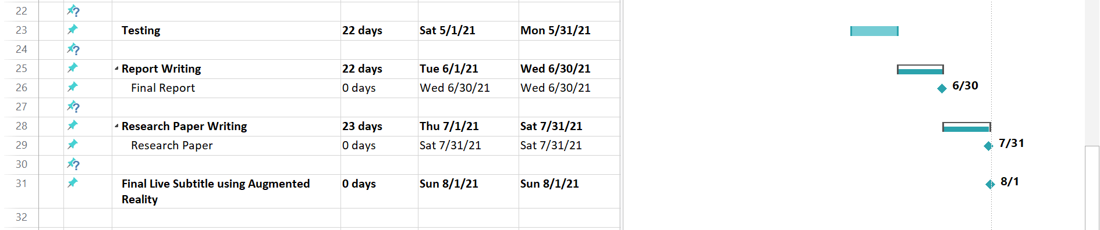

Slide 13
TASK DIVISION
AUDIO AND TEXT EXTRACTION + TRANSLATION
Mahrukh Khan
Syeda Sara Akif
ANDROID APPLICATION DEVELOPMENT
Ifrah Ishtiaq
Ameema Arif

Slide 14
Audio Extraction & Translation

Slide 15

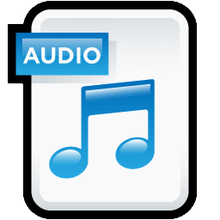
Audio Extraction from Video
Audio Extraction
Video
Audio File

Slide 16

Python Library for Video to Audio Conversion
“Movie Py”

Slide 17
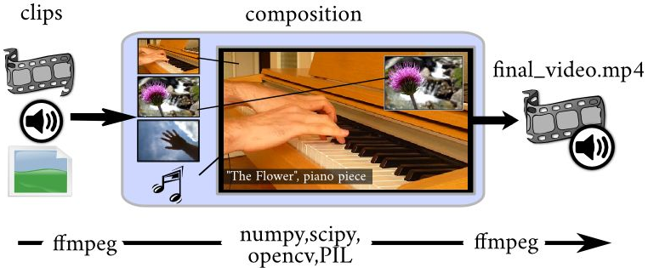
Python Library for Video to Audio Conversion

Slide 18

Textual Extraction from Audio
Textual Extraction
Audio File
Text File

Slide 19
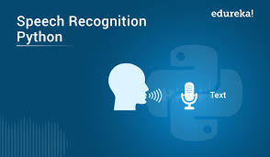
Libraries for Textual Extraction from Audio Files
1. Speech recognition is mostly free and allows documents to be created faster because the software generally produces words as quickly as they uttered, which is usually much faster than a person can type.

Slide 20
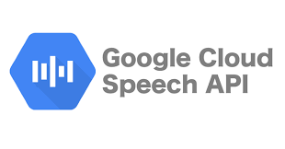
Libraries for Textual Extraction from Audio Files
2. Google Cloud Speech API:
The Google Speech-To-Text API isn't free, however. It is free for speech recognition for audio less than 60 minutes. For audio transcriptions longer than that, it costs $0.006 per 15 seconds.

Slide 21

Translation of Text File
Translation
Text File
Translated Text File

Slide 22
Libraries Available for Translation of Textual Files
Google translator
Google Cloud Translator API
Microsoft Translator API
So we have used Google Translator for Textual Extraction from Audio.

Slide 23
Mobile Application Development

Slide 24
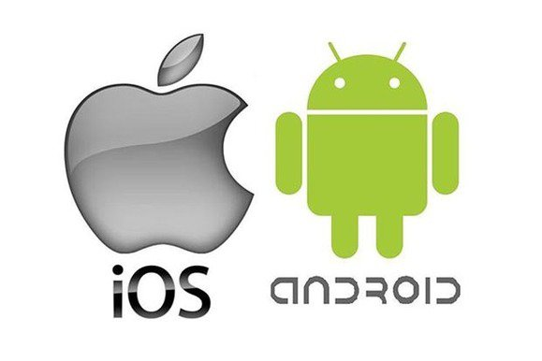
Step 01: Choosing an Appropriate Platform for our Application
Android
IoS
OR

Slide 25
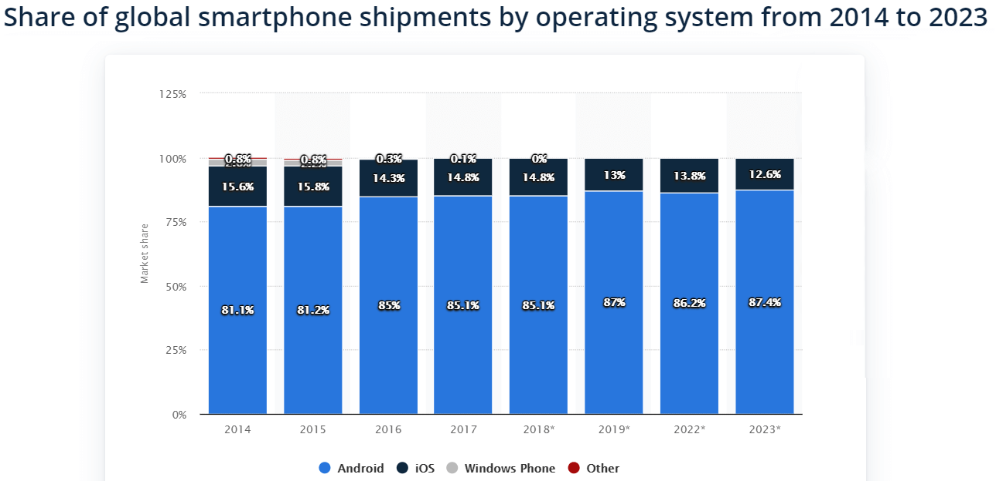
Choosing Android
Choosing Android considering the following 2 factors:
i. Market share

Slide 26
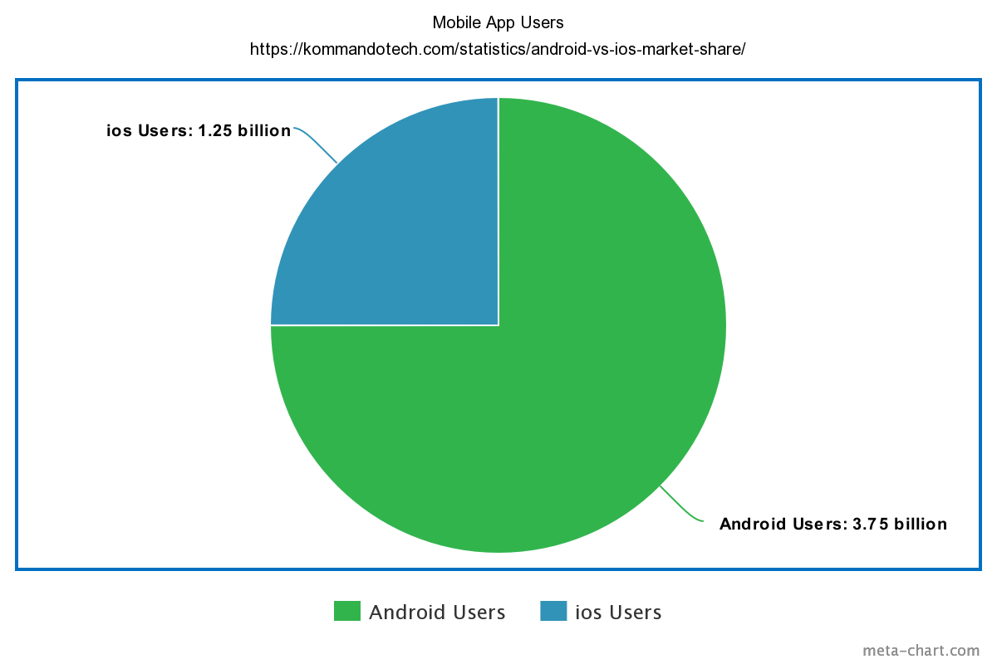
ii. App Users
Total Mobile Users: 5 billion Android Users: 3.75 billion IoS Users: 1.25 billion

Slide 27
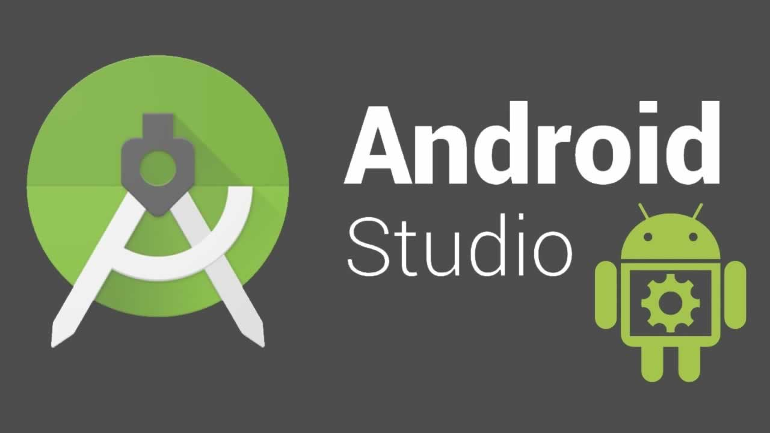
Step 02: Choosing Software for Android Application Development
Android Studio

Slide 28
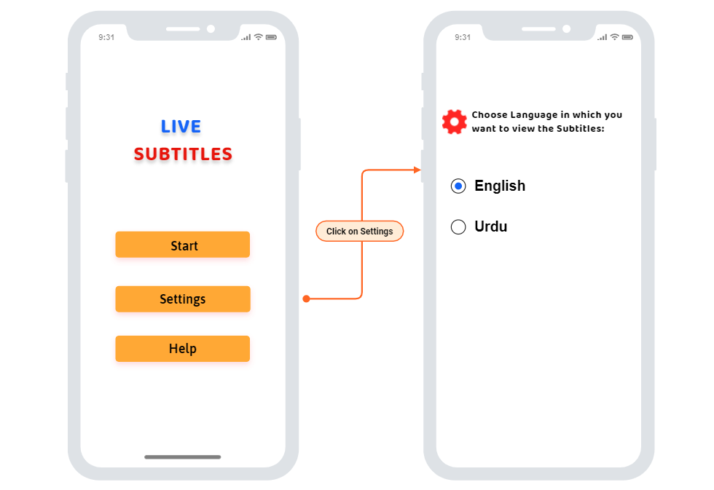
Step 03: Designing the Wireframes
Main Screen
Start
Start
Live Camera Streaming with subtitle display
Settings
Choose desired Language
Settings
Help
Help
Basic guidelines on how to use

Slide 29
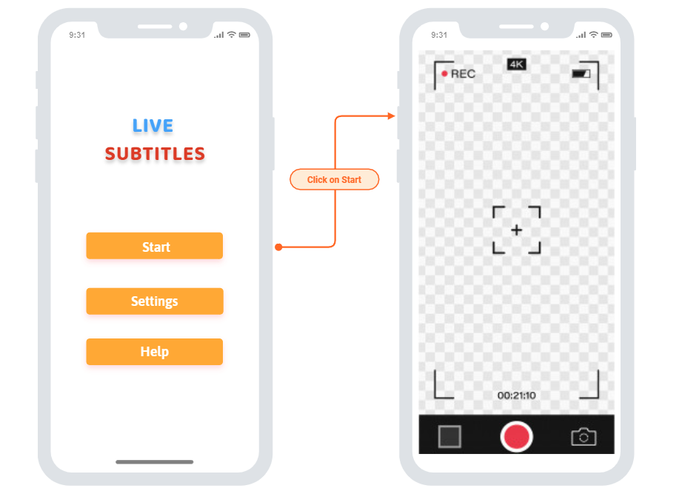
Start Interface Wireframe

Slide 30
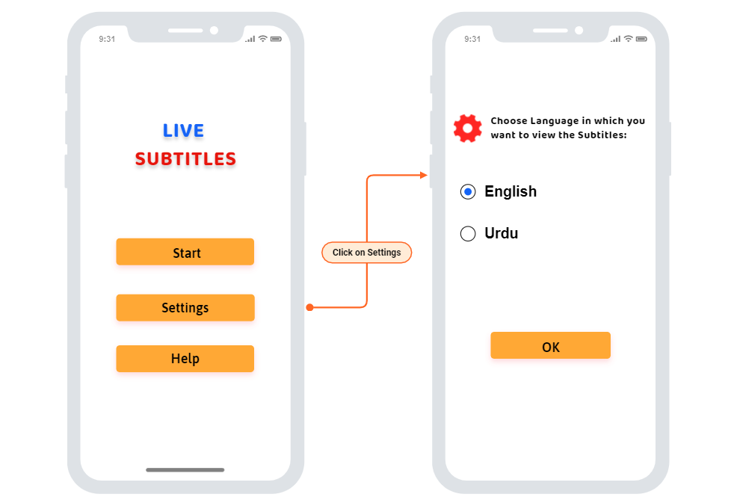
Settings Interface Wireframe

Slide 31
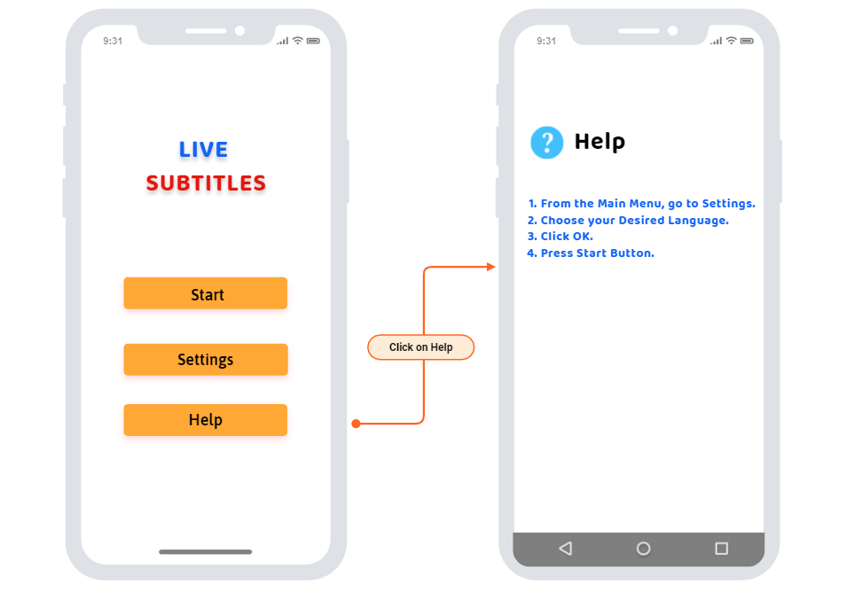
Help Interface Wireframe

Slide 32
Step 04: Implementing The Wireframes into Actual Interfaces
Display in Demo Session

Slide 33
Milestones achieved
Audio Extraction from Video
Textual Extraction from Audio
Translation of Text
Android Application

Slide 34
Future plan
Real time Audio Extraction with Translation
Augmented Reality
Integration of all modules
Testing

Slide 35
Thank You

